Slide 1
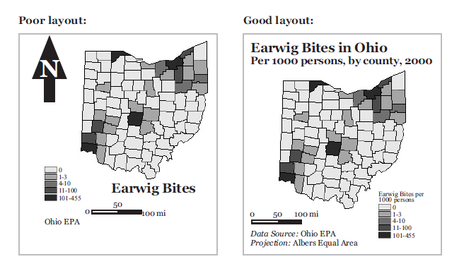
Layout….
Notes:
http://makingmaps.owu.edu/mm/MakingMapsCh06.pdf

Slide 2
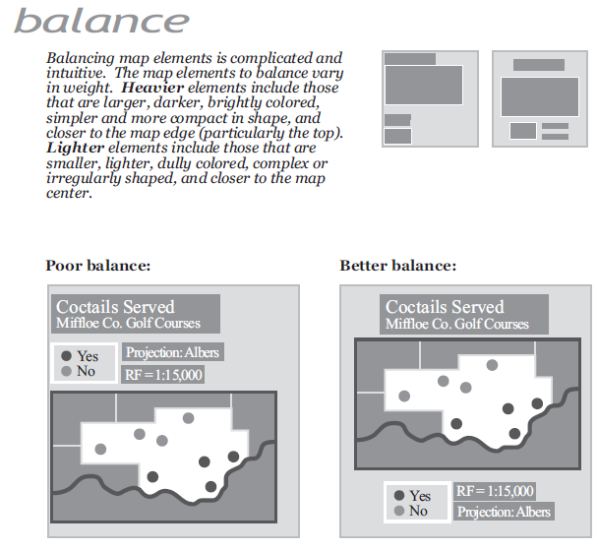
Layout….
Notes:
http://makingmaps.owu.edu/mm/MakingMapsCh06.pdf

Slide 3
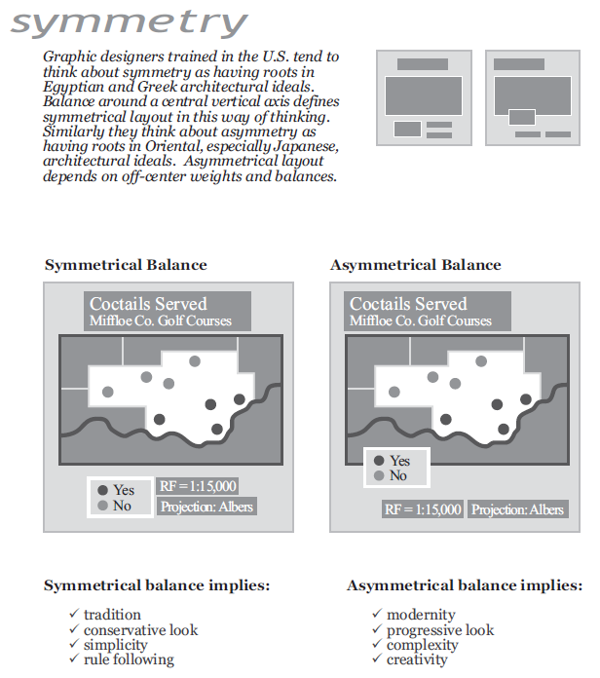
Layout….
Notes:
http://makingmaps.owu.edu/mm/MakingMapsCh06.pdf

Slide 4
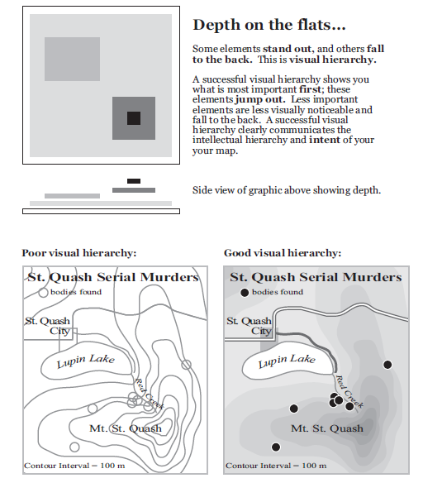
Visual
Hierarchies….
Notes:
http://makingmaps.owu.edu/mm/MakingMapsCh07.pdf

Slide 5
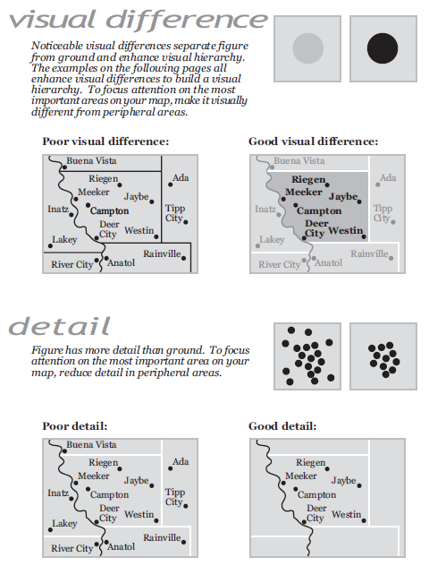
Visual
Hierarchies….
Notes:
http://makingmaps.owu.edu/mm/MakingMapsCh07.pdf

Slide 6
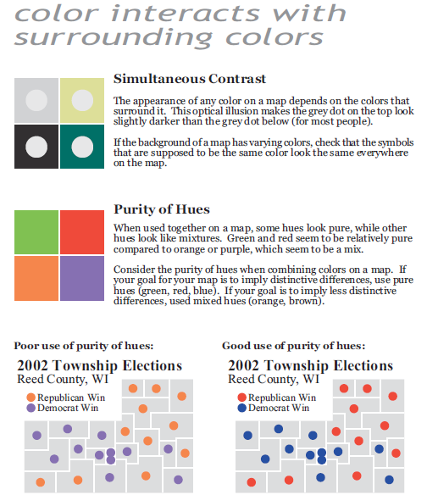
Colors….
Notes:
http://makingmaps.owu.edu/mm/MakingMapsCh11.pdf

Slide 7
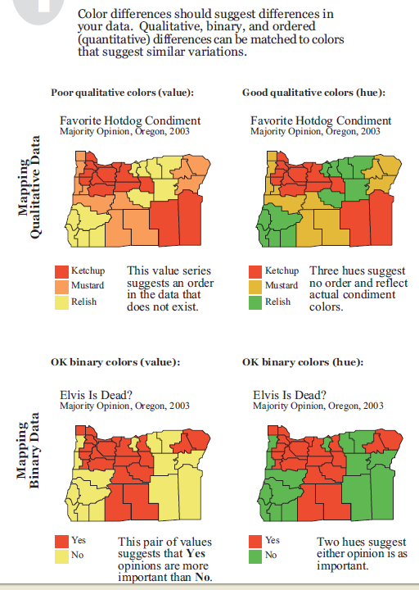
Colors….
Notes:
http://makingmaps.owu.edu/mm/MakingMapsCh11.pdf

Slide 8
Colors….
Notes:
http://makingmaps.owu.edu/mm/MakingMapsCh11.pdf

Slide 9
Colors….
Color Blender—
http://www.colorblender.com/
Color Brewer--
http://colorbrewer2.org/

Slide 10
example before and after maps

Slide 11
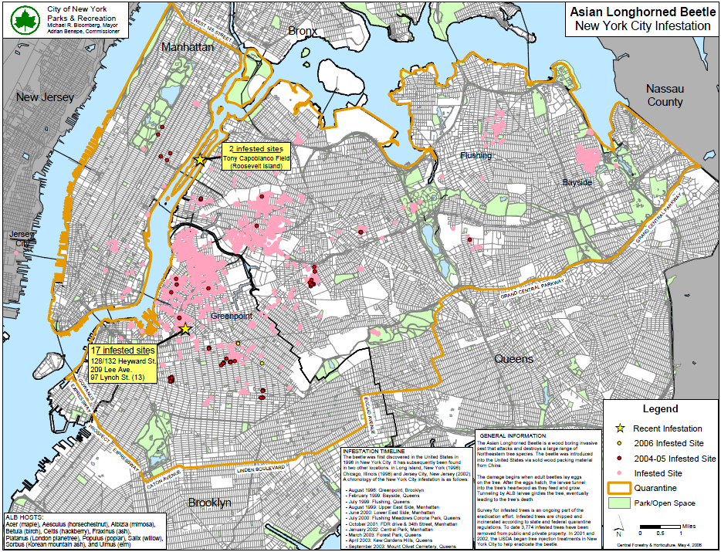
Notes:
Before – BAD!

Slide 12
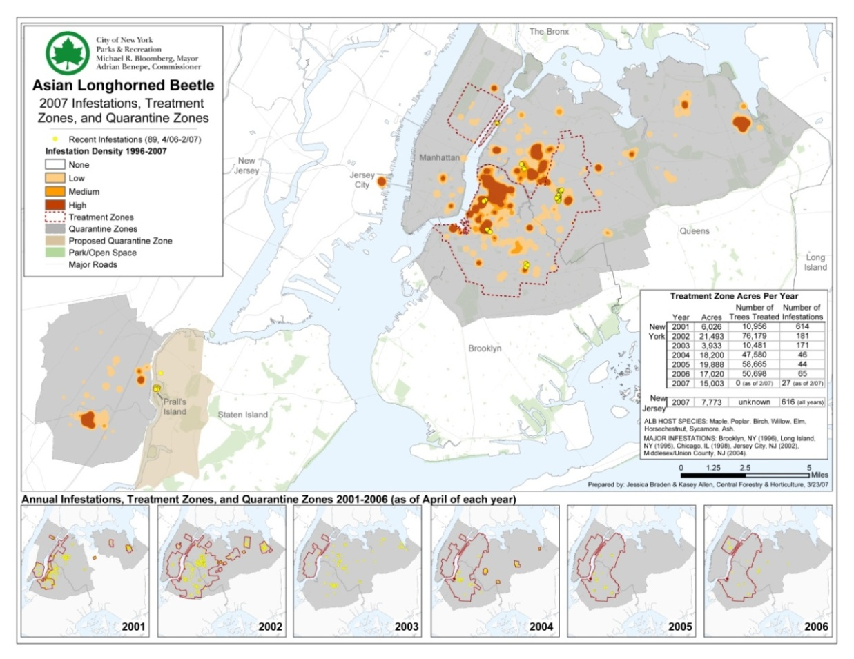
Notes:
after

Slide 13
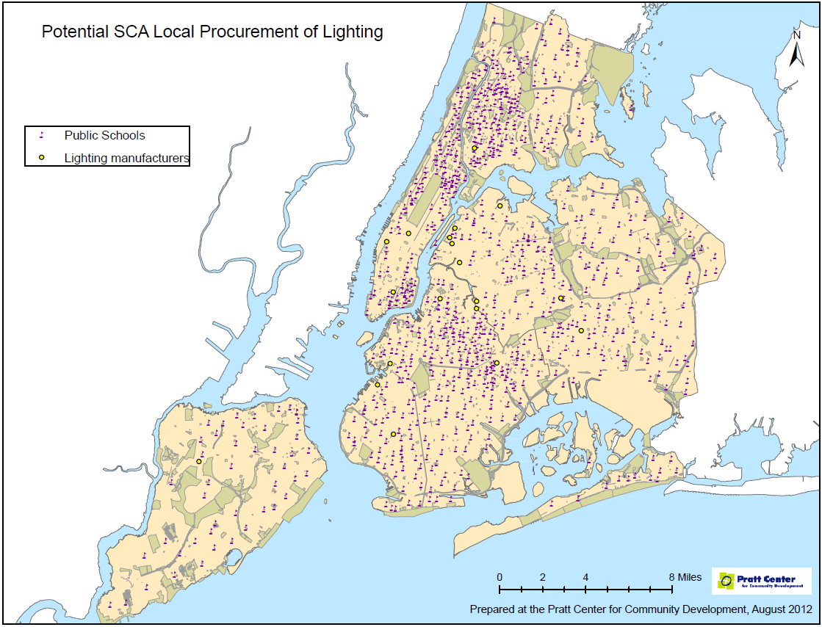
Notes:
before

Slide 14
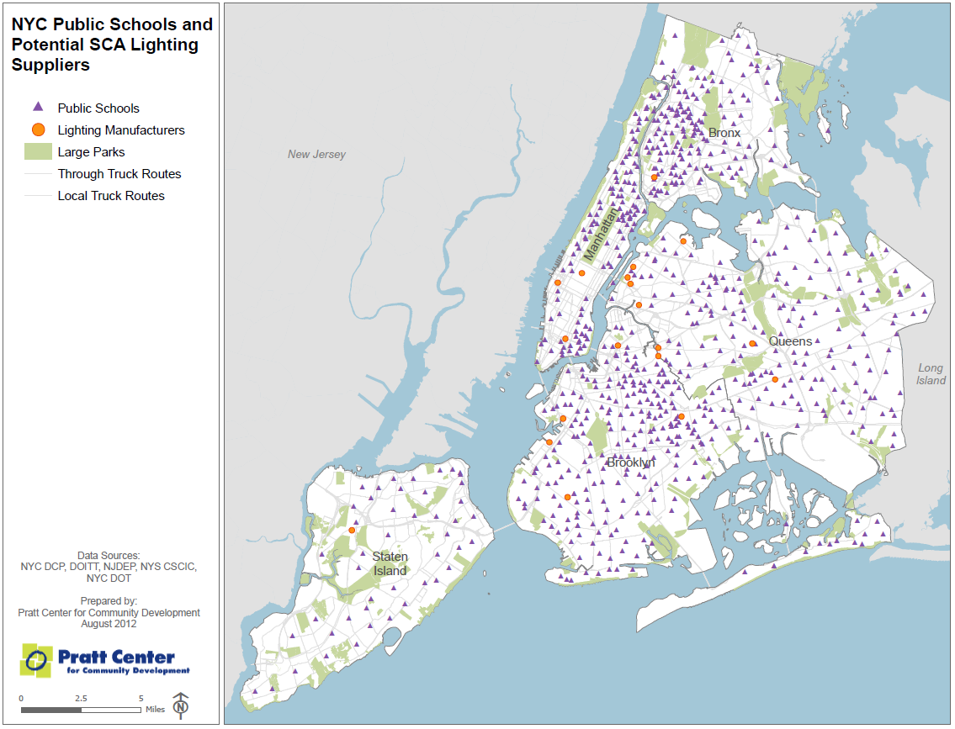
Notes:
after

Slide 15
nice maps

Slide 16
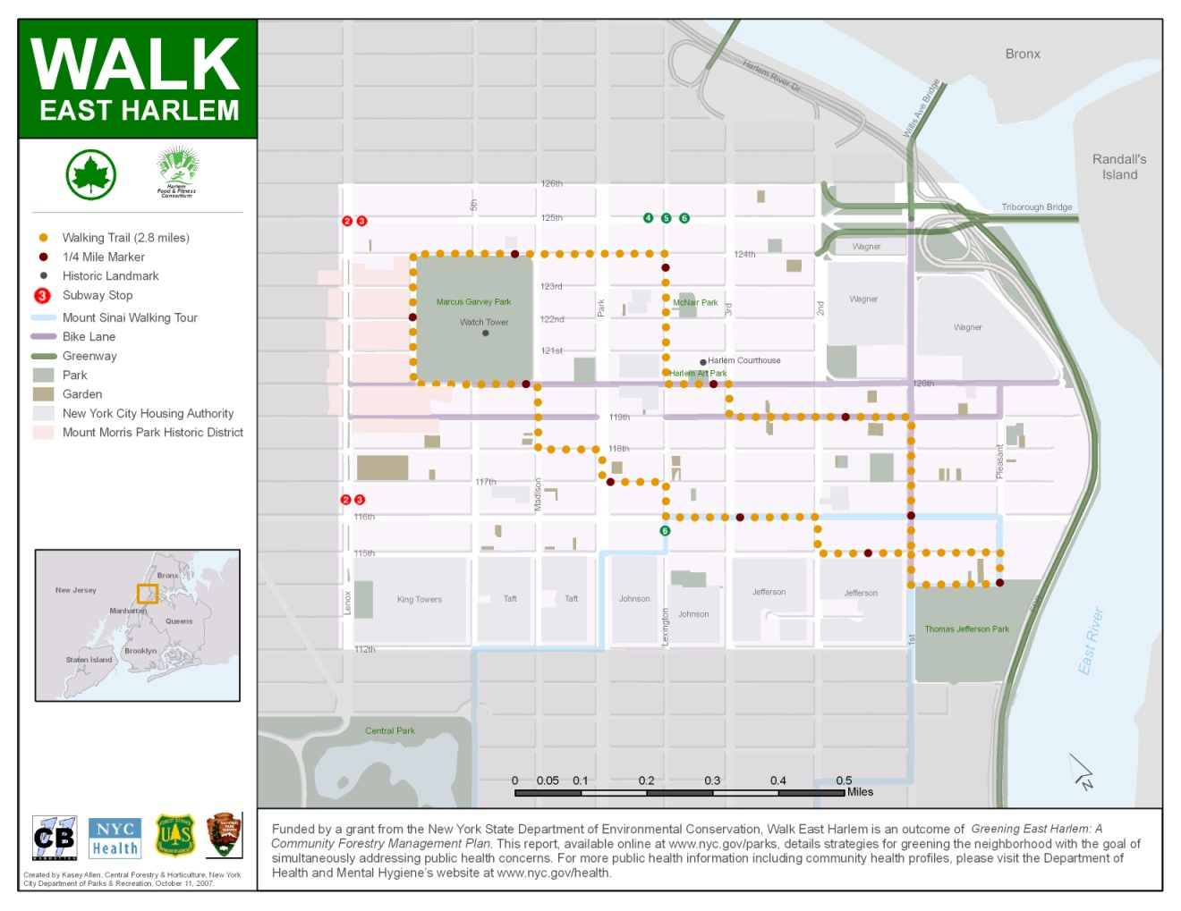
Notes:
Good map

Slide 17
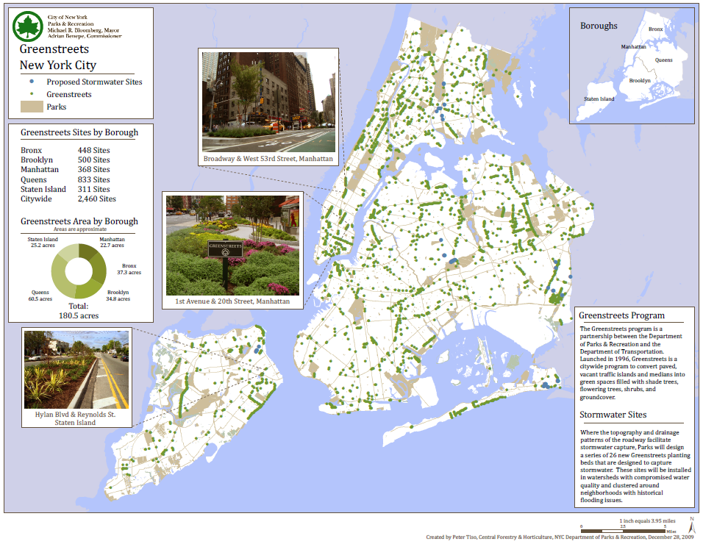

Slide 18
charts & graphs
for data visualization
make ‘em useful…and pretty

Slide 19
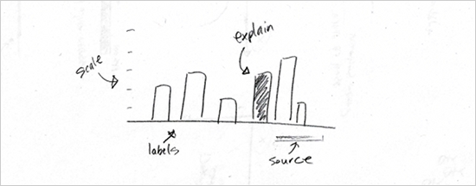
basic rules for charts
http://flowingdata.com/2010/07/22/7-basic-rules-for-making-charts-and-graphs/

Slide 20
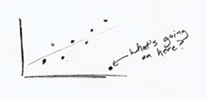
check the data
http://flowingdata.com/2010/07/22/7-basic-rules-for-making-charts-and-graphs/

Slide 21
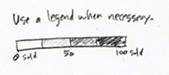
explain encodings
http://flowingdata.com/2010/07/22/7-basic-rules-for-making-charts-and-graphs/

Slide 22
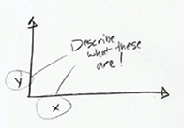
label axes
http://flowingdata.com/2010/07/22/7-basic-rules-for-making-charts-and-graphs/

Slide 23
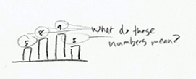
include units
http://flowingdata.com/2010/07/22/7-basic-rules-for-making-charts-and-graphs/

Slide 24
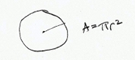
pay attention to geometry
http://flowingdata.com/2010/07/22/7-basic-rules-for-making-charts-and-graphs/

Slide 25
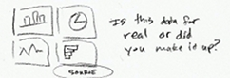
include sources
http://flowingdata.com/2010/07/22/7-basic-rules-for-making-charts-and-graphs/

Slide 26
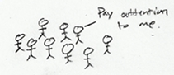
consider the audience
http://flowingdata.com/2010/07/22/7-basic-rules-for-making-charts-and-graphs/

Slide 27
charts & graphs
good guidelines

Slide 28
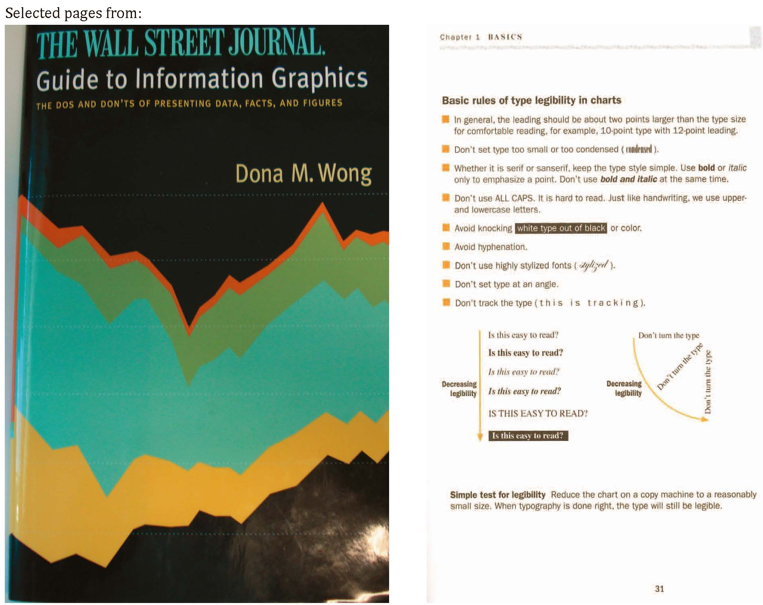

Slide 29
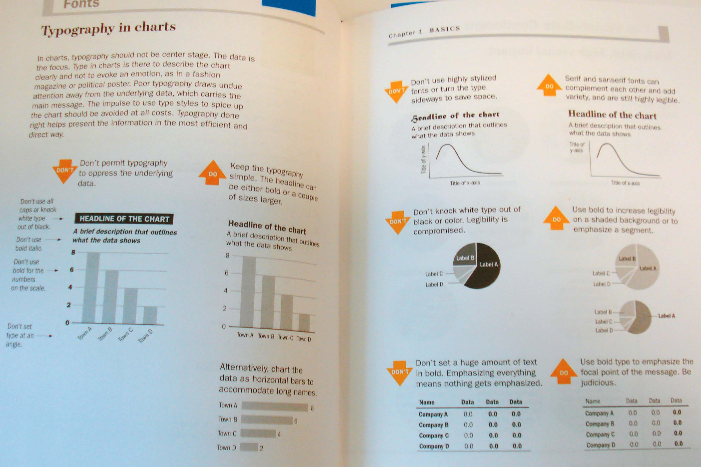

Slide 30
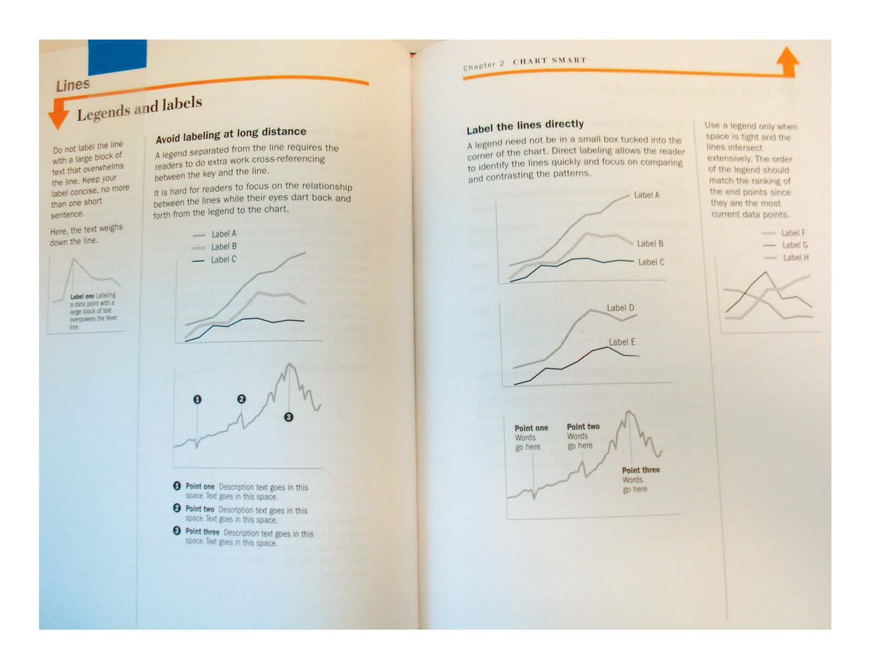

Slide 31
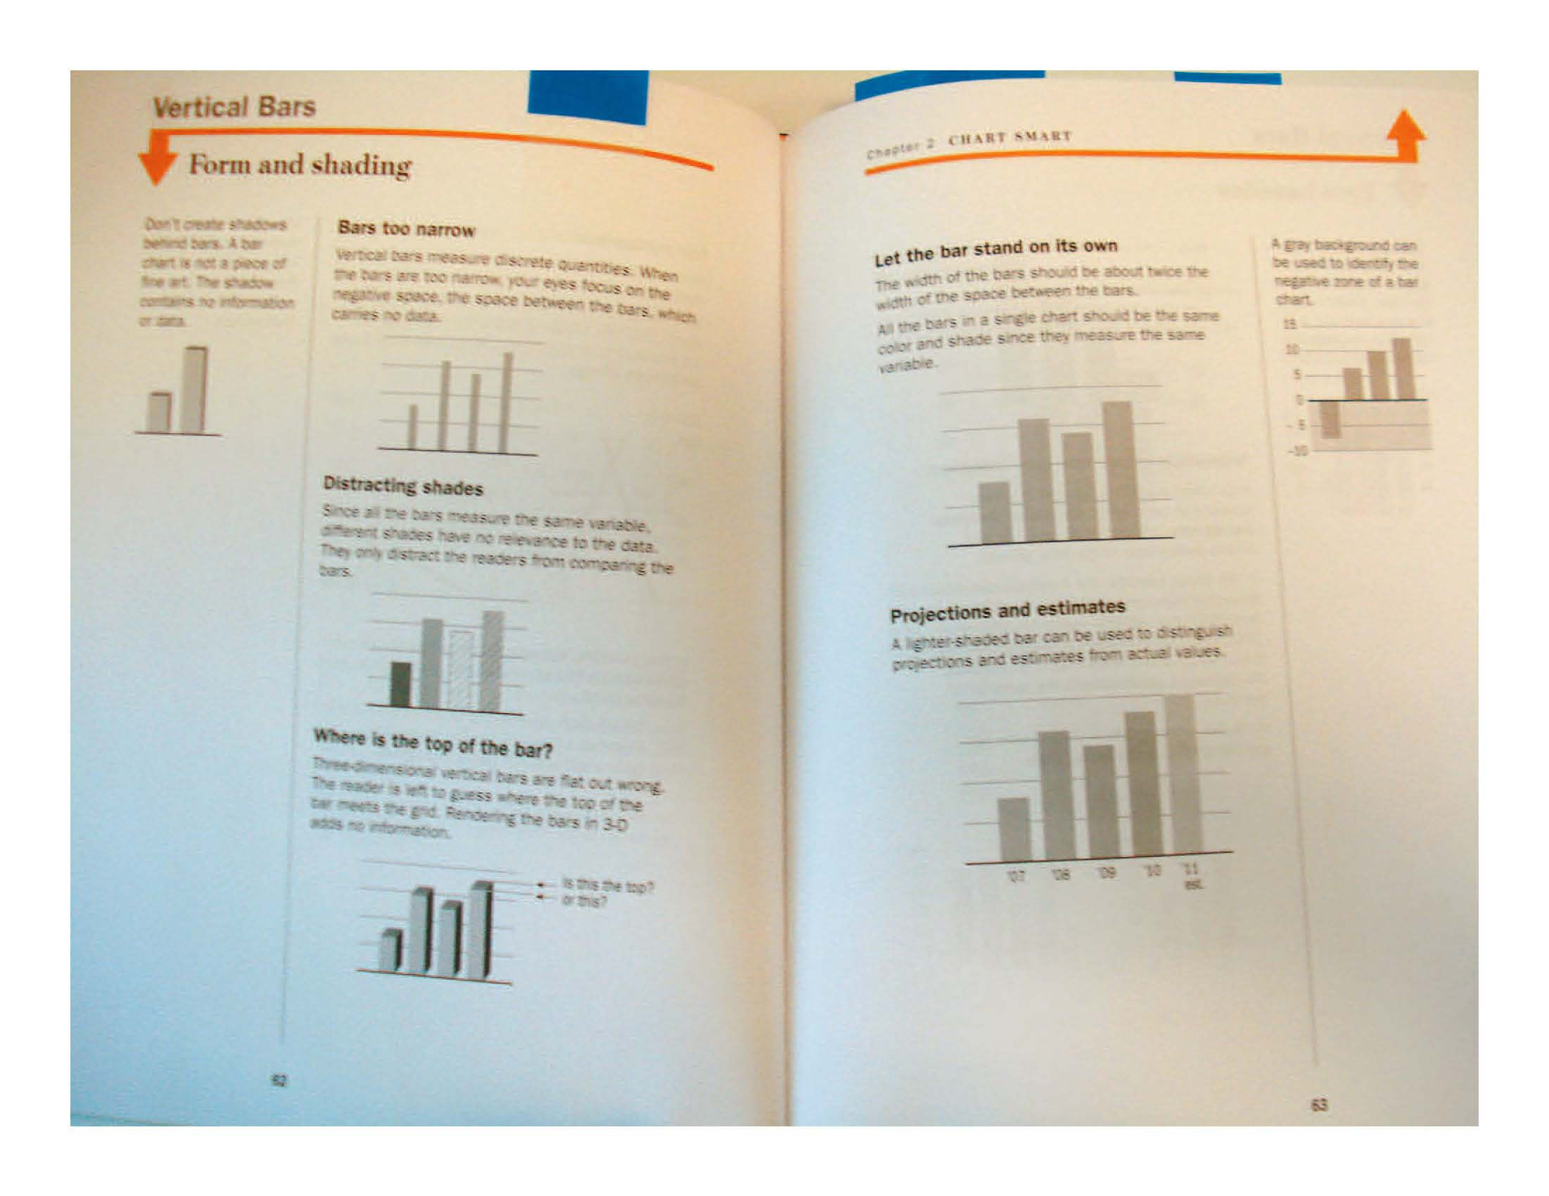

Slide 32
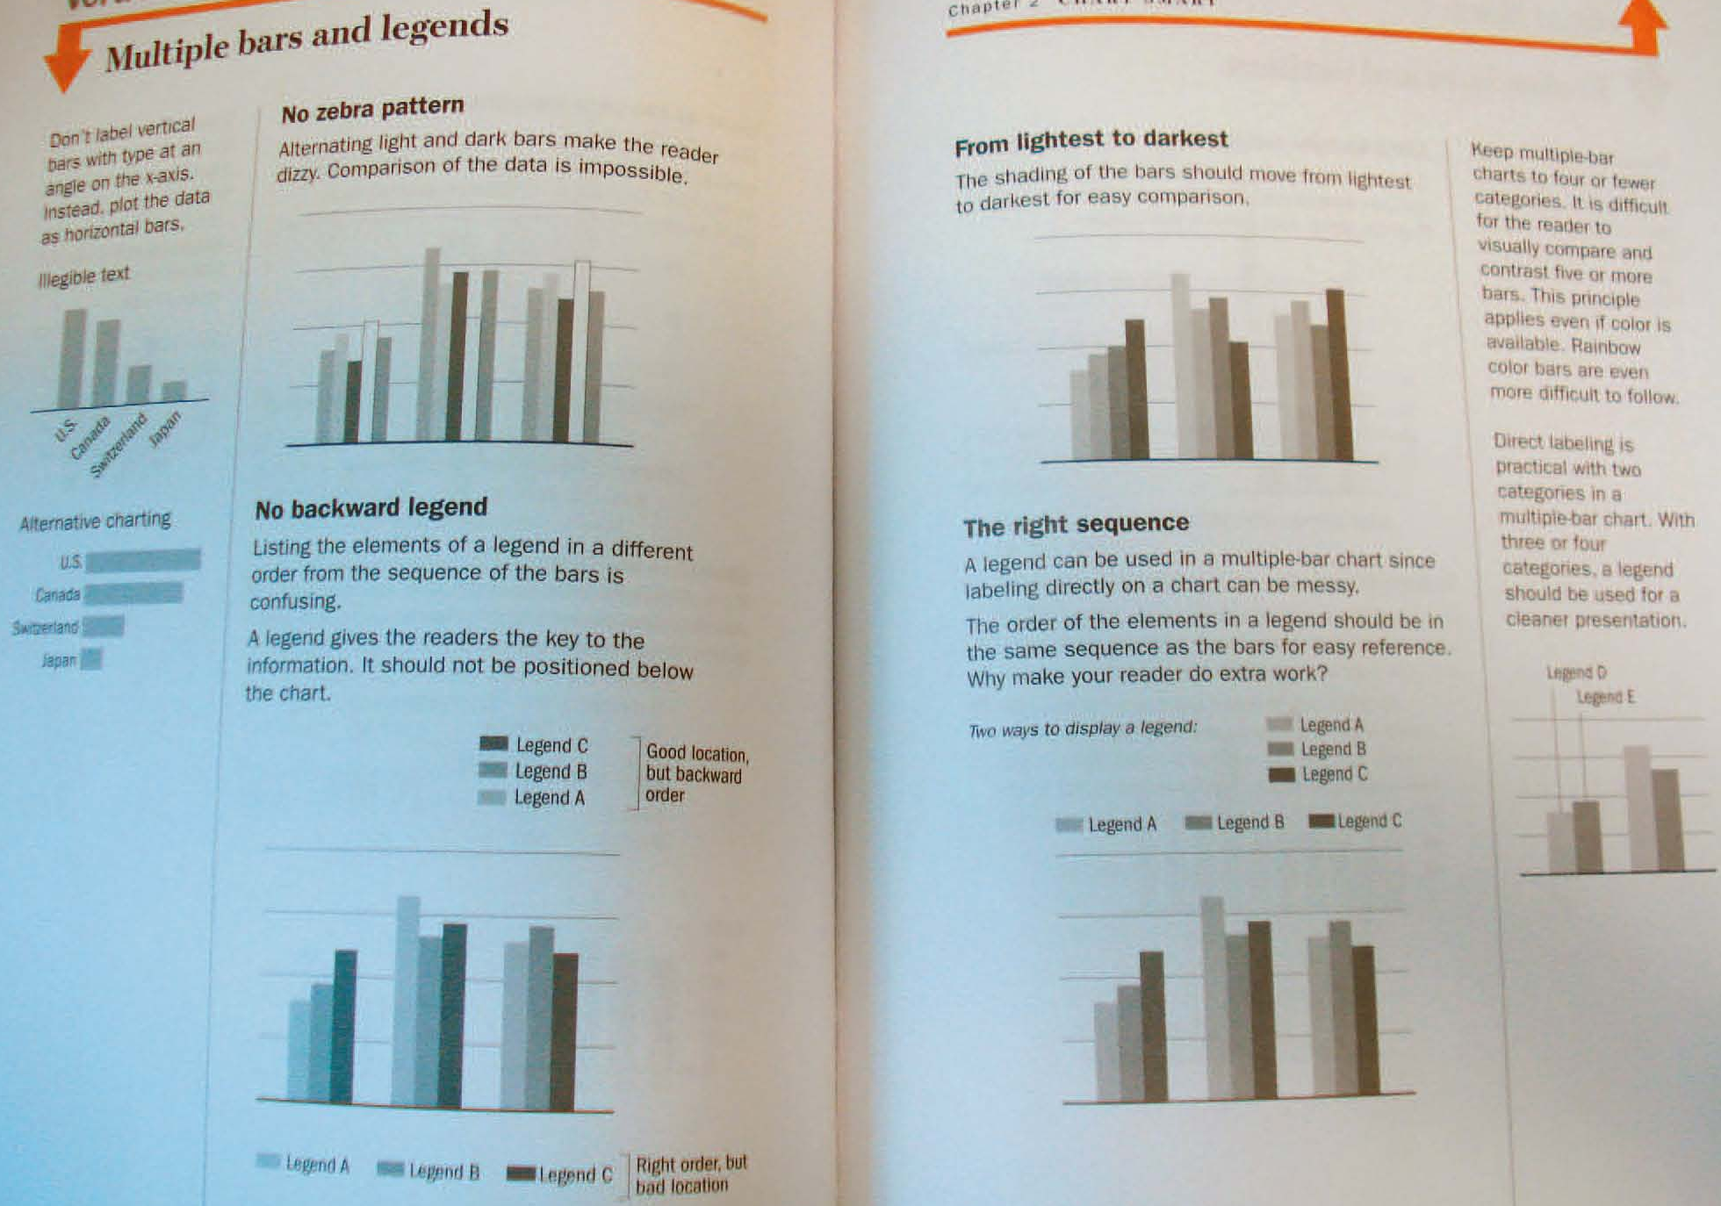

Slide 33
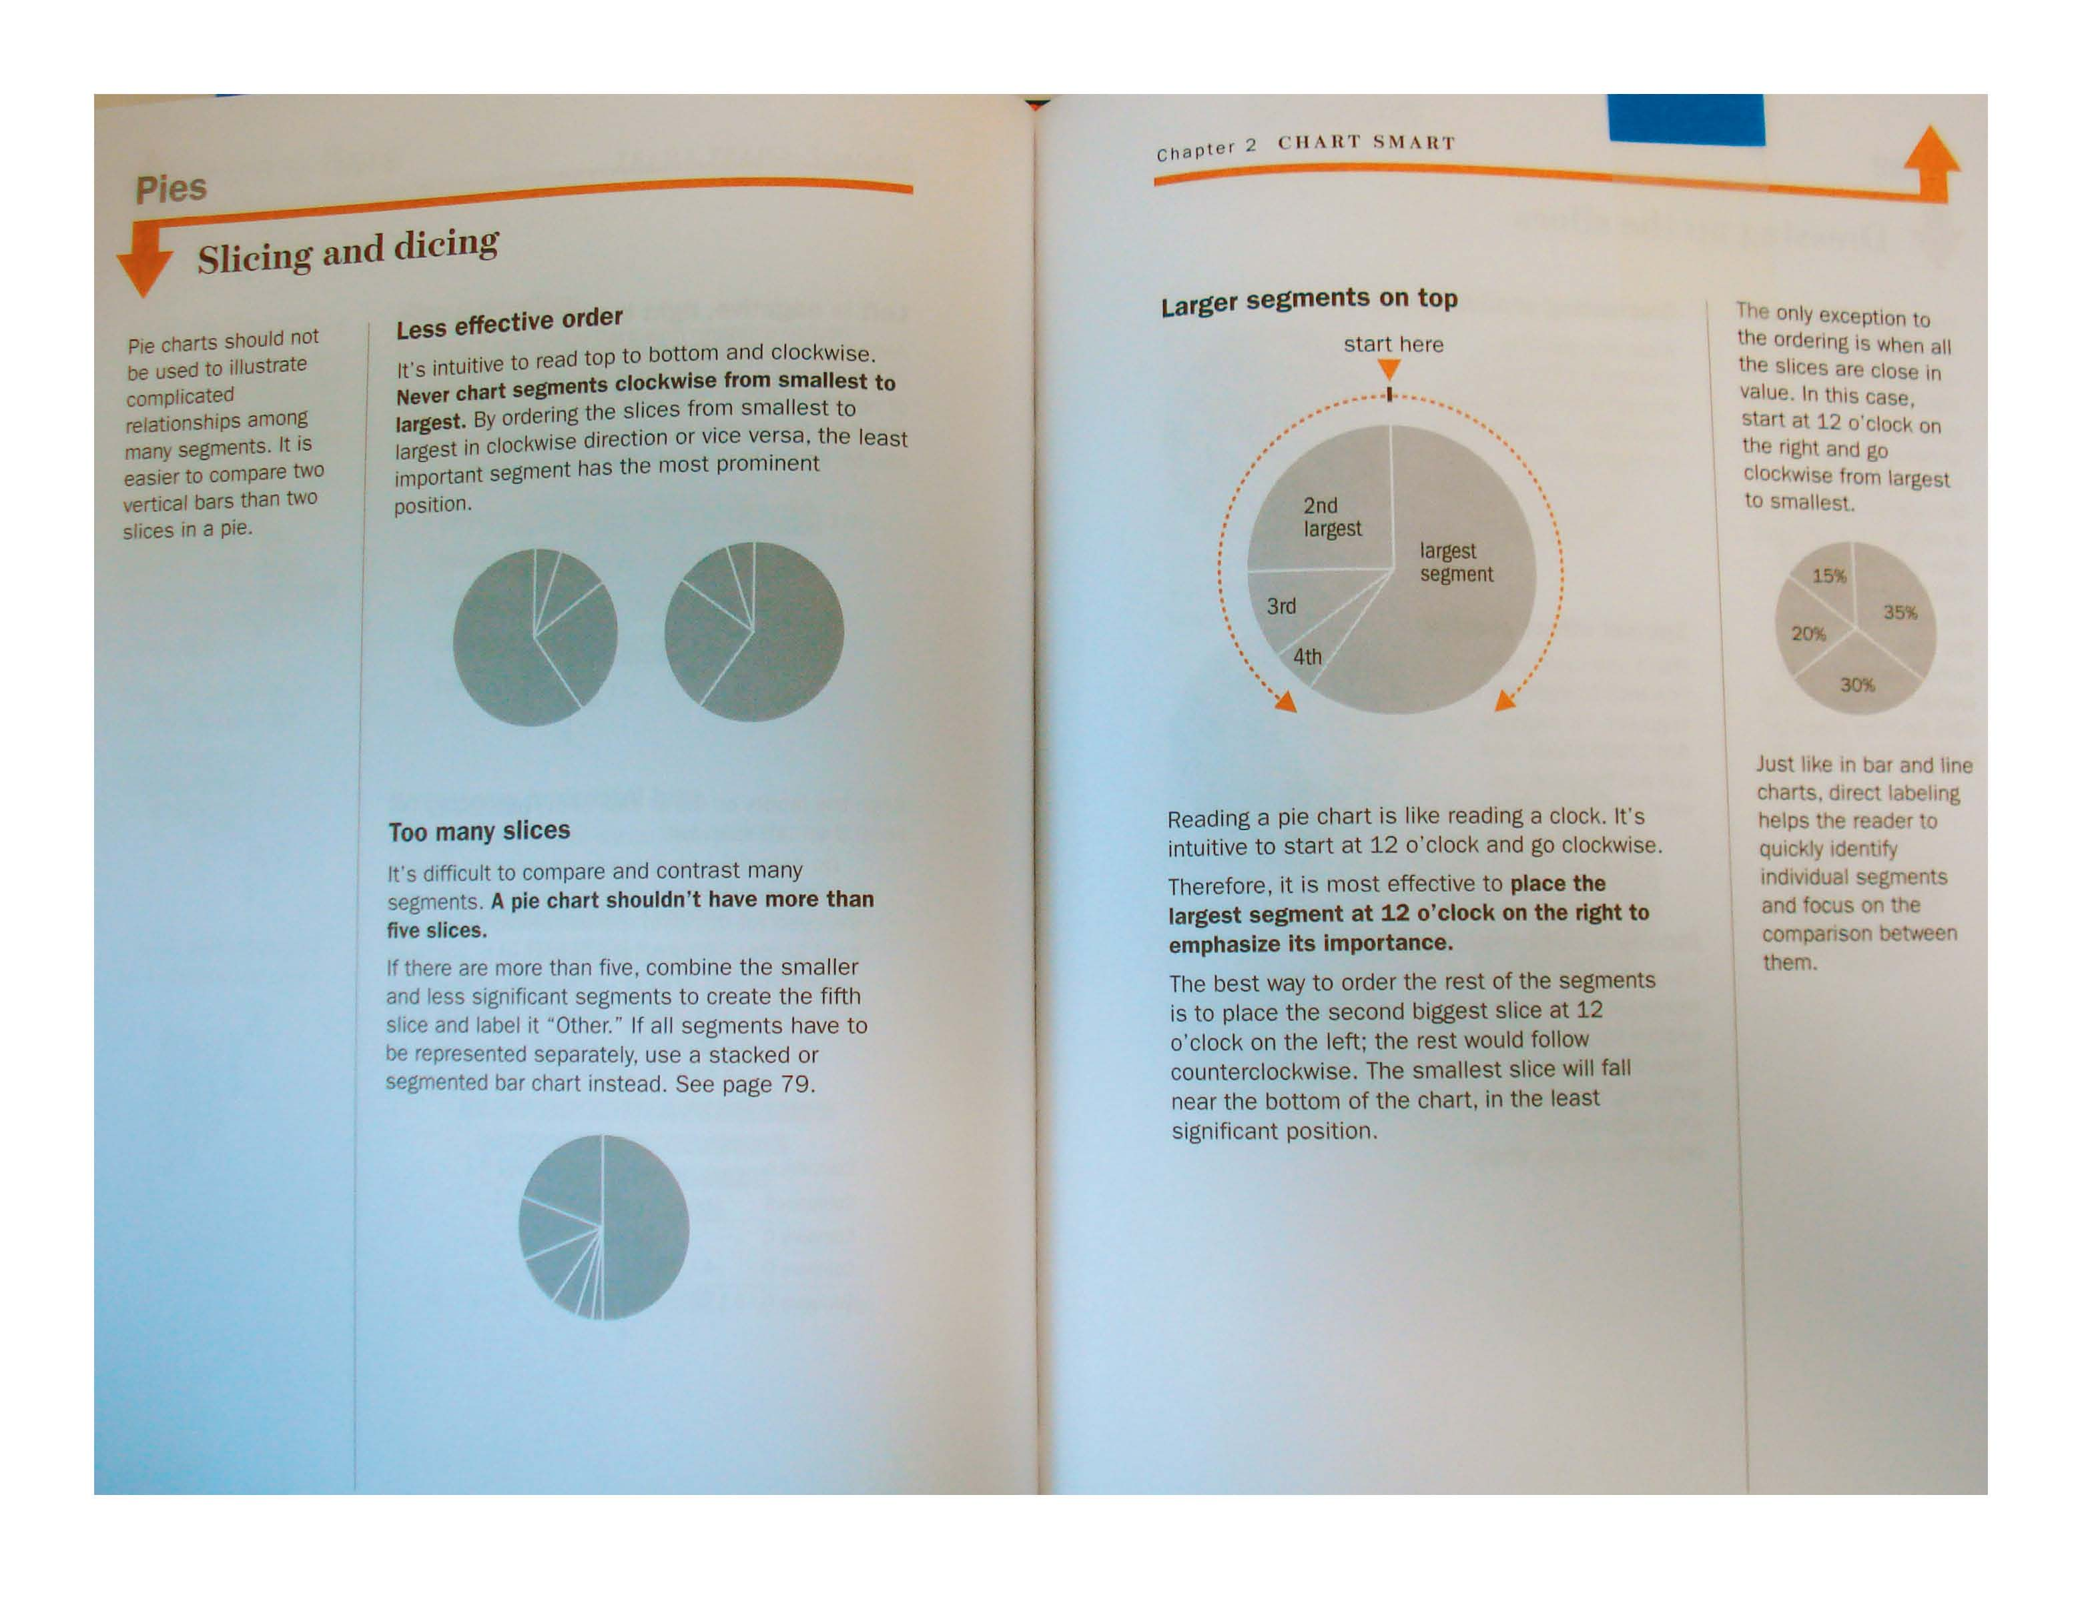

Slide 34
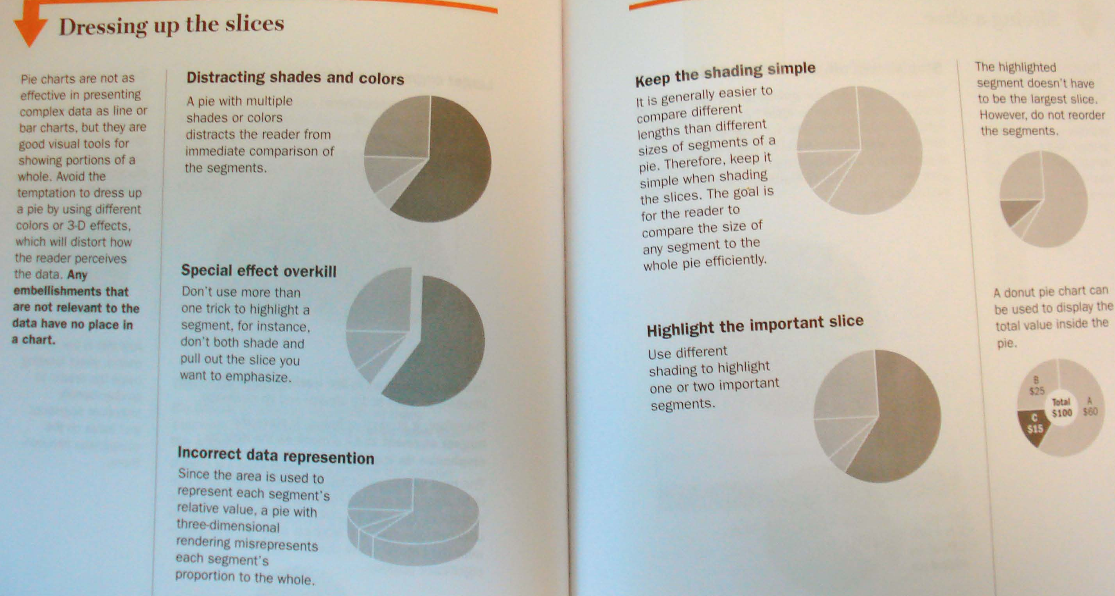

Slide 35
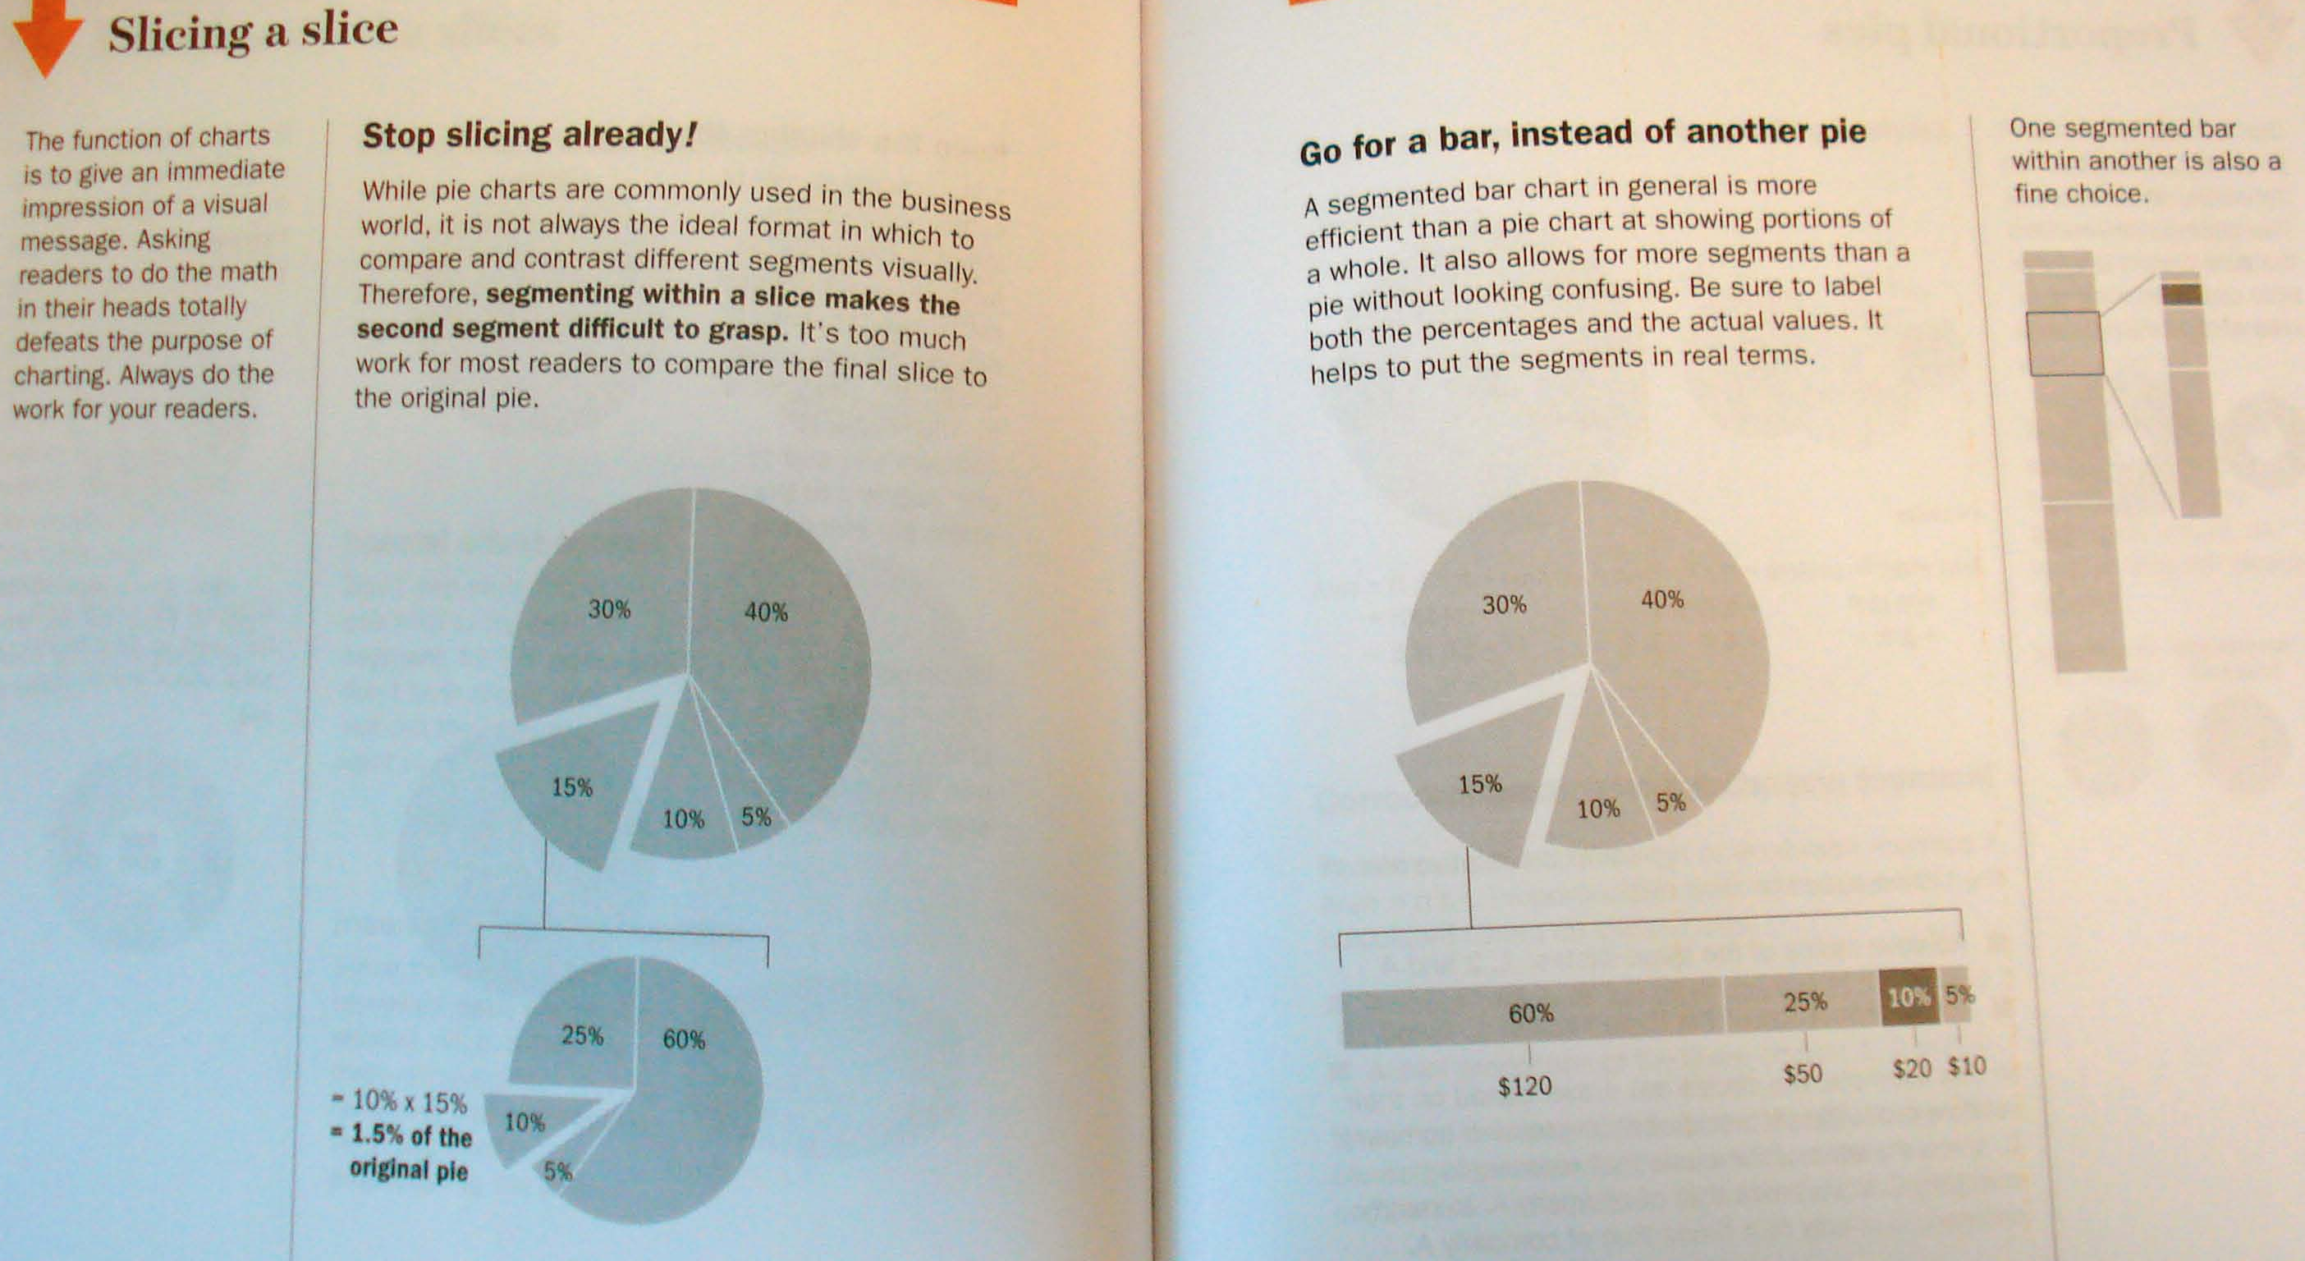

Slide 36
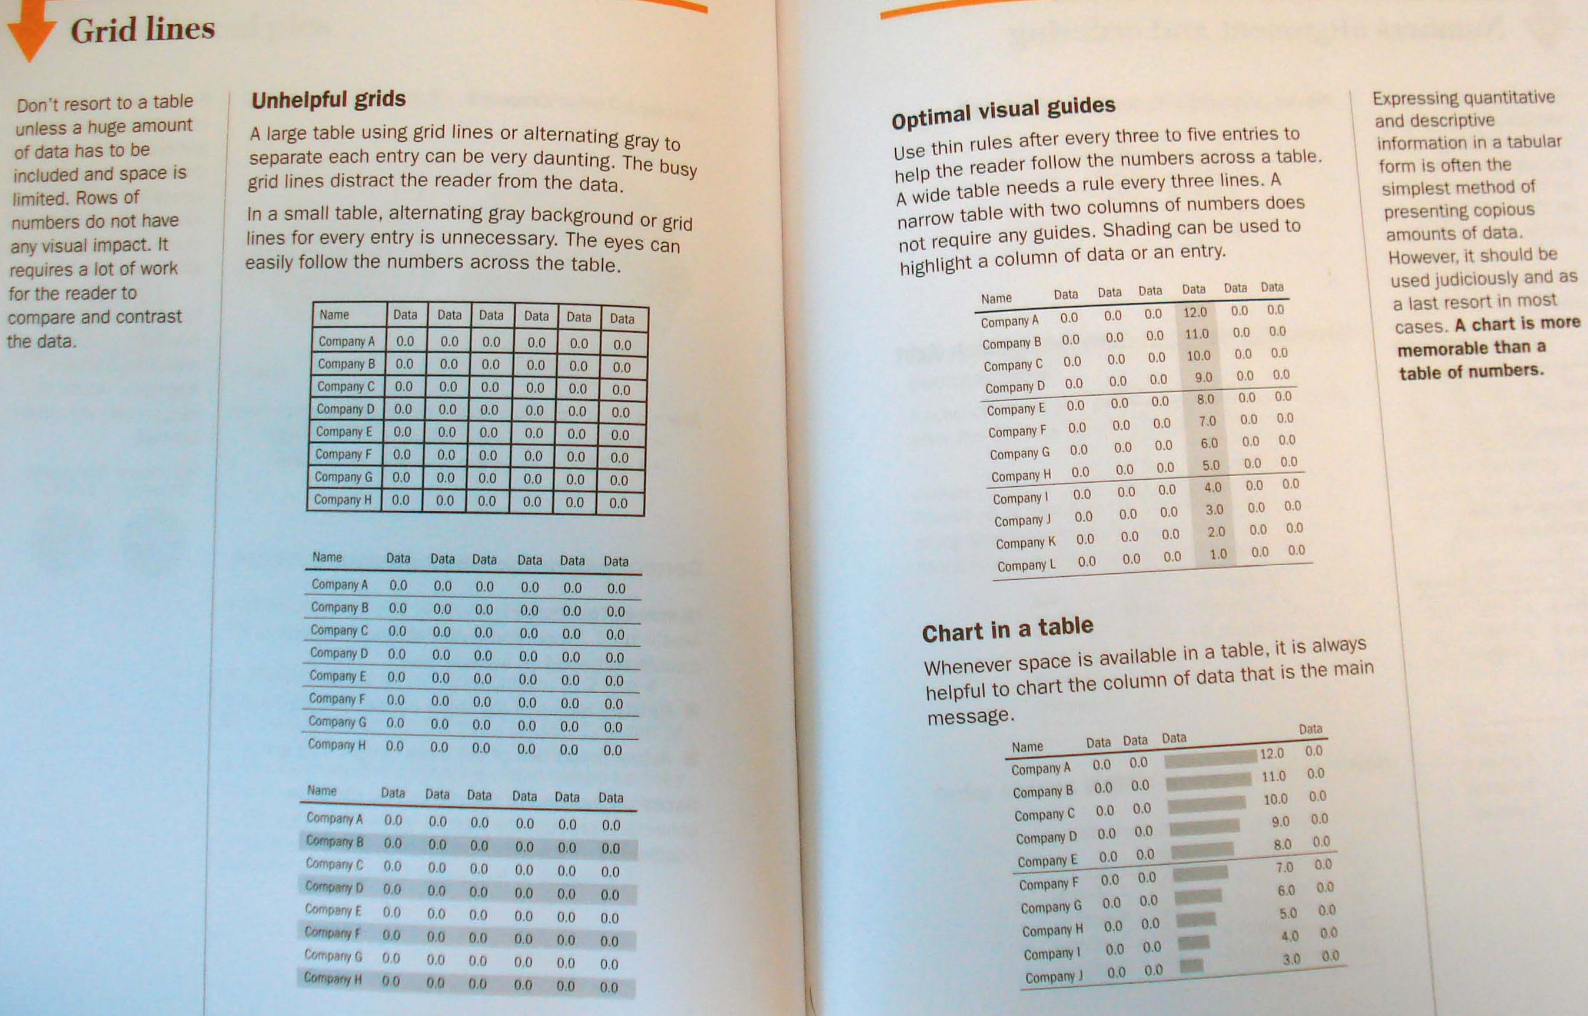

Slide 37
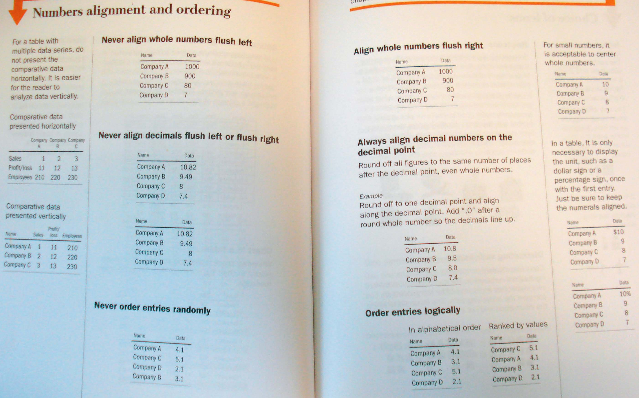

Slide 38
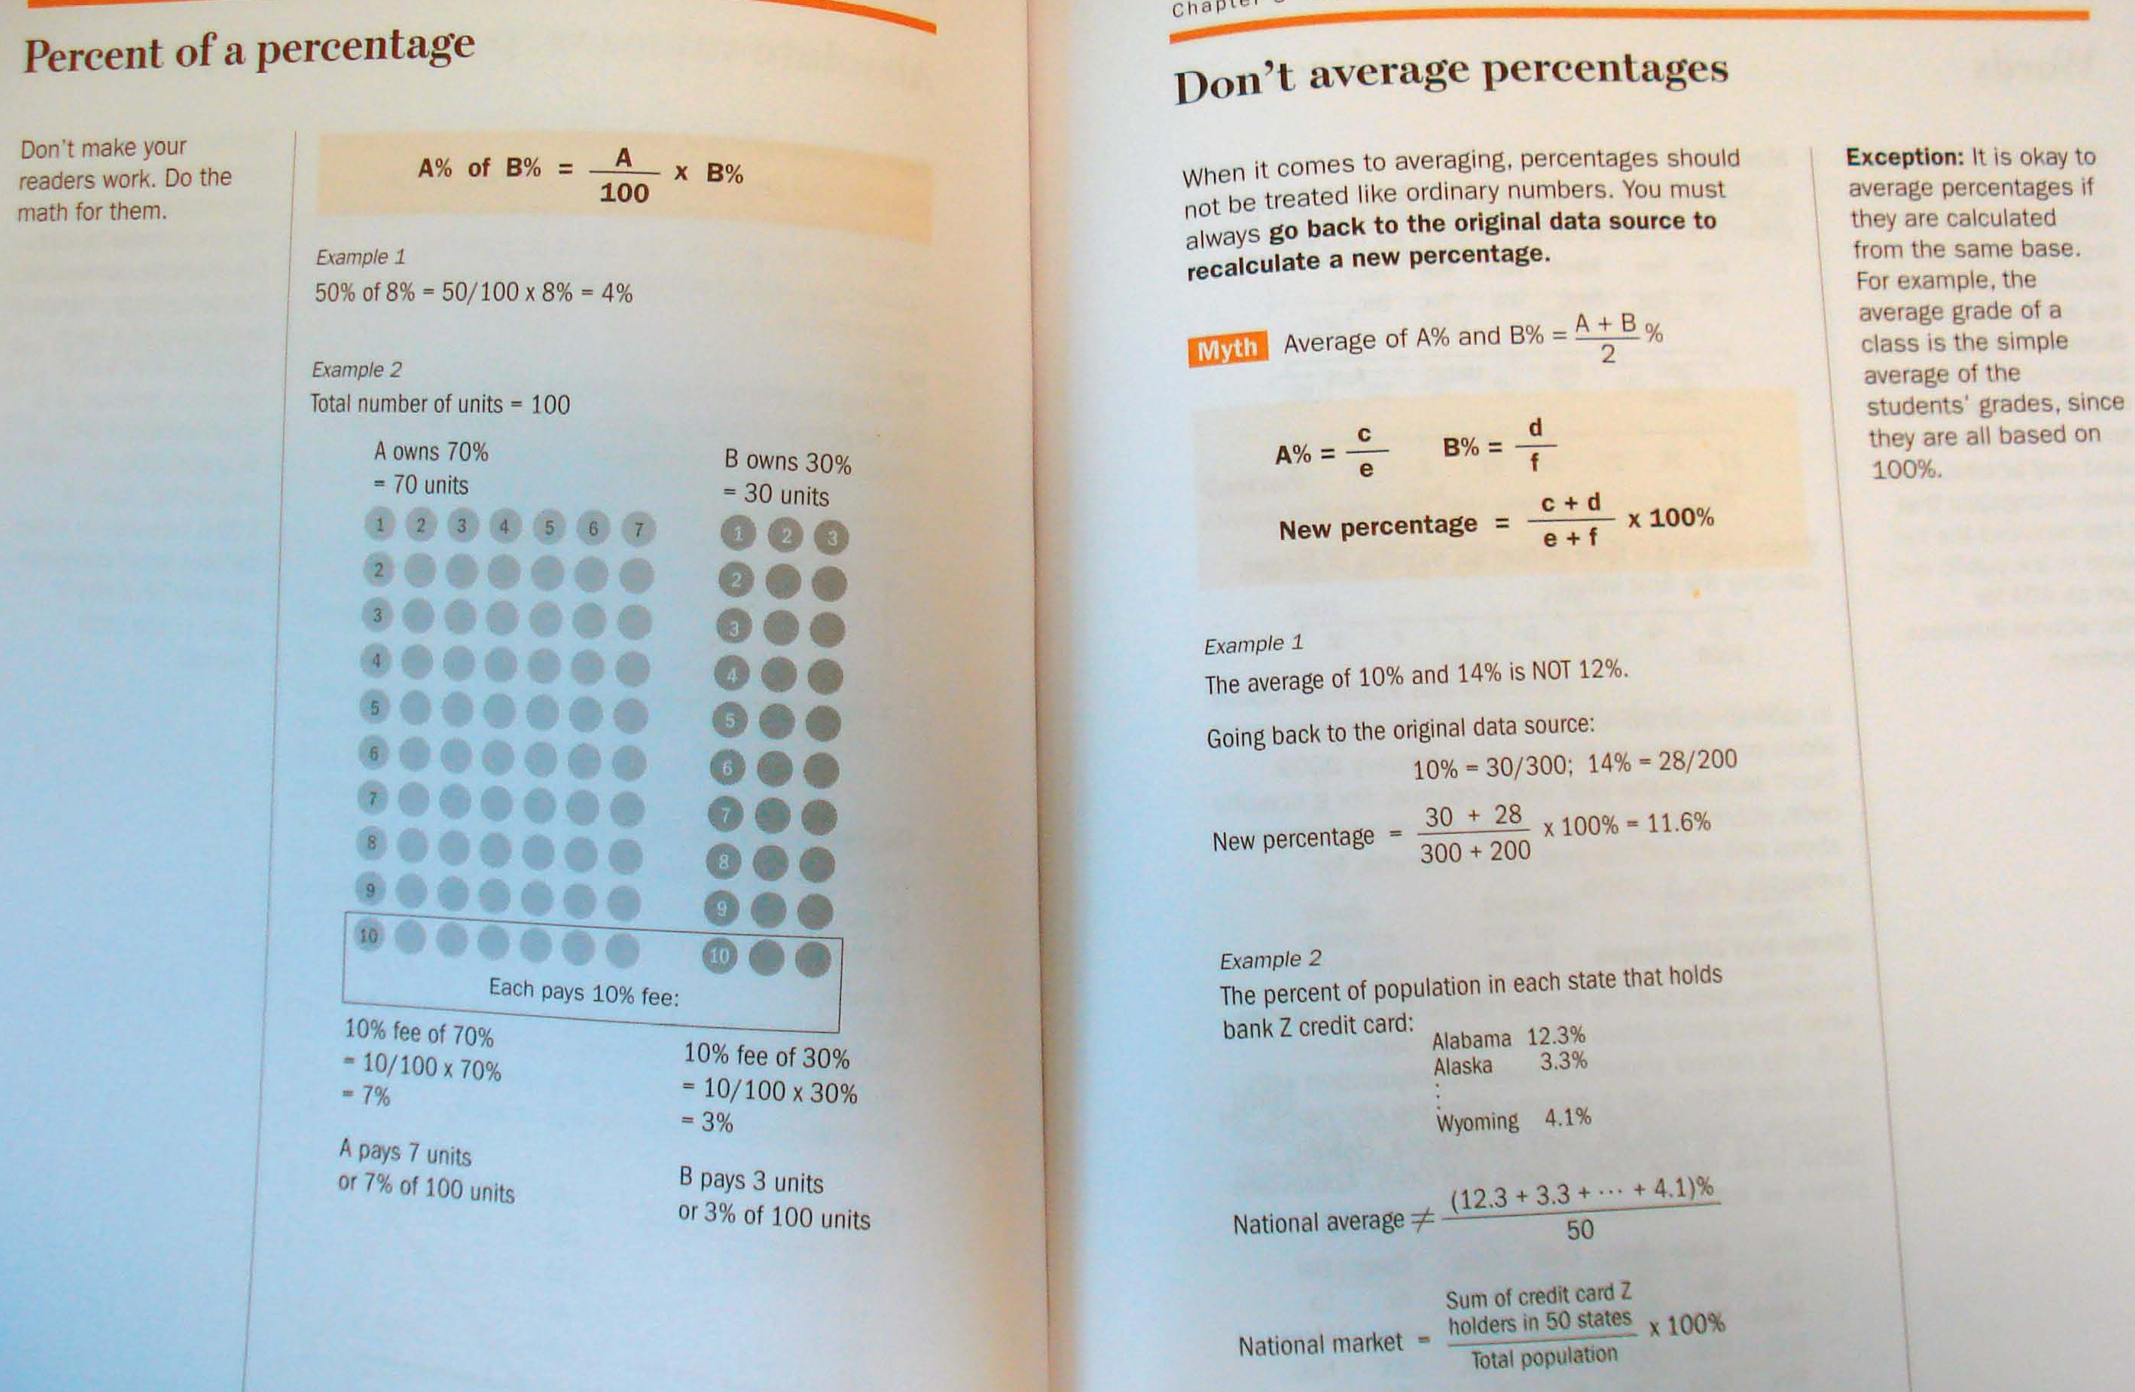

Slide 39
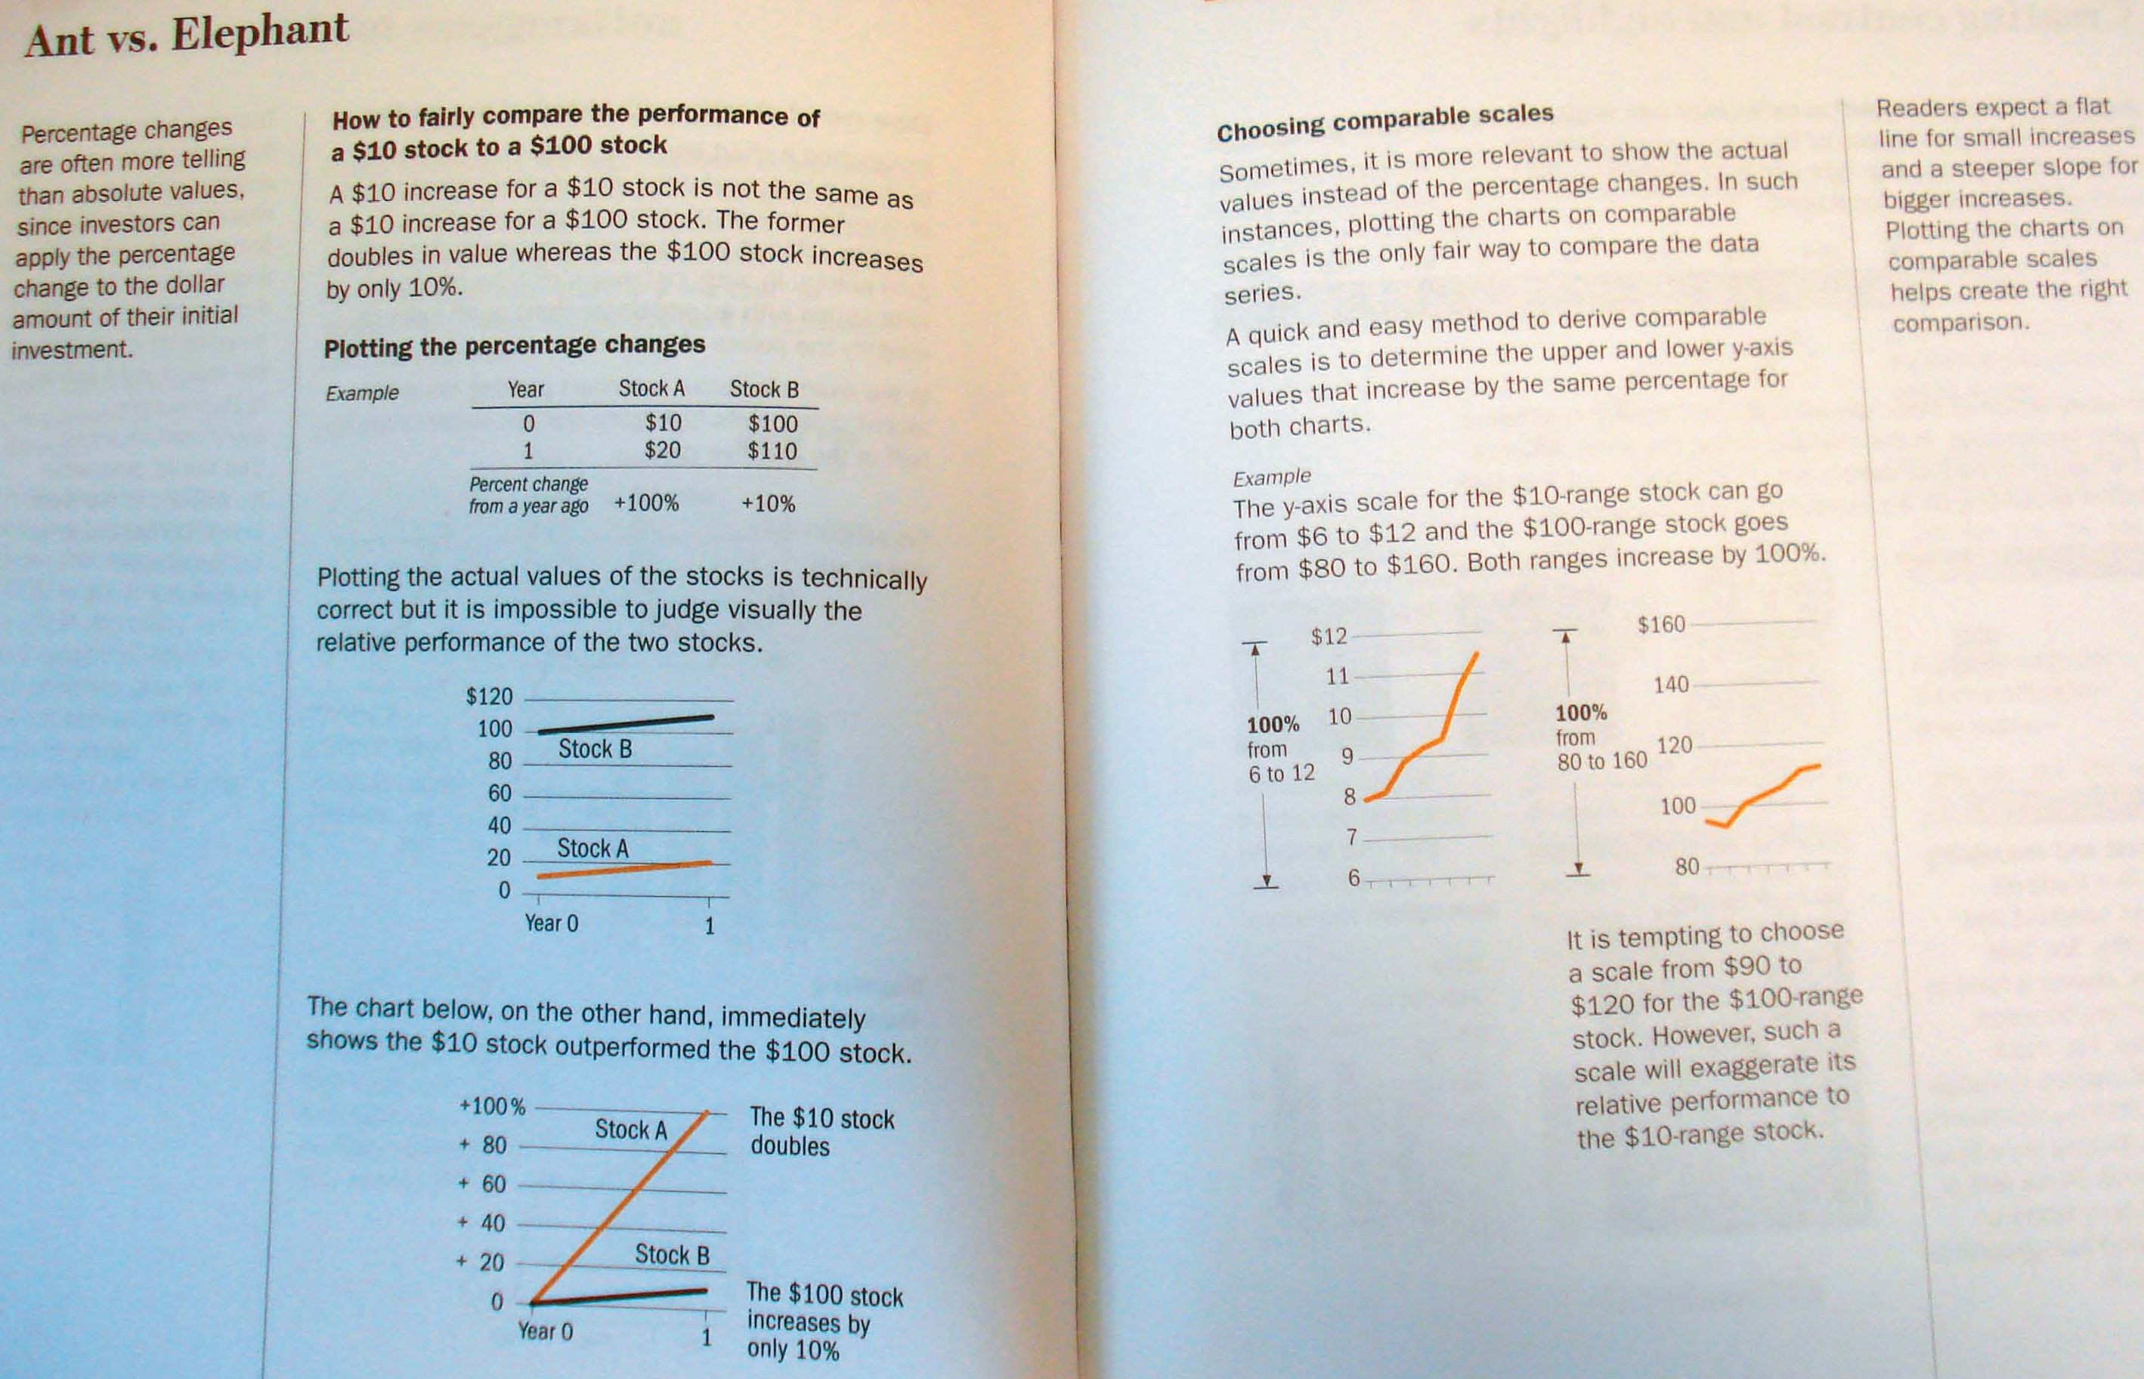

Slide 40
